Slide 1

eMall – e-Mobility For All
R&DD
Software Engineering 2 Project
Academic year 2022 – 2023
Balestrieri Niccolò
Bertogalli Andrea
Tombini Nicolò

Slide 2
GOALS
Allow end users to find a most suitable charging station for them
1
2
Allow end users to make bookings and manage them
Allow end users to start/monitor/stop the charging process
3
4
Allow CPOs to monitor their
charging stations as the internal and external status
Allow CPOs to retrieve information about the price
from the DSOs
5
6
Allow CPOs to decide how to use purchased energy
and also decide its selling price
7
Allow end users to automatically pay for a charge

Slide 3


WORLD & MACHINE PHENOMENA
World Phenomena
End user drives to the chosen charging station
End user needs to charge his vehicle
End user leaves the charging station
CPO owns the charging station
Machine Phenomena
eMall shows stations which are near to the user
eMall shows costs and offers about the station
eMall provides a QR-Code scanner to check bookings
eMall shows to the CPO information about available DSOs

Slide 4




DOMAIN ASSUMPTIONS
Charging Socket
All charging sockets are "charging columns" with only one cable
attachment.
QR-Codes
QR-Codes are associated with a specific user reservation.
TimeSlot
A timeslot begins and ends only at the hour on the dot.
CPO
CPO is the representative for a certain company.

Slide 5
REQUIREMENTS
1
The system must show to the end user the suggested charging stations
The system must allow the end user to start the charging process
2
The system must allow the CPO to monitor the charging process
3
4
The system must allow the CPO to acquire energy from DSOs

Slide 6
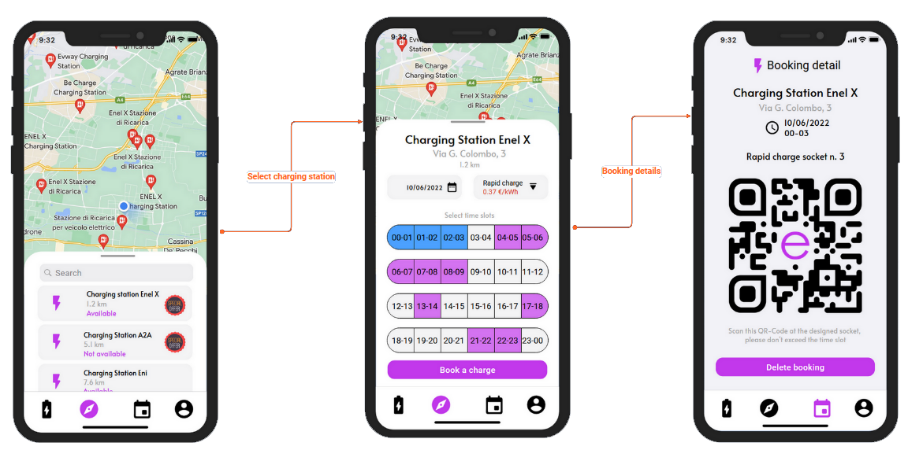
USE CASES – New Booking

Slide 7
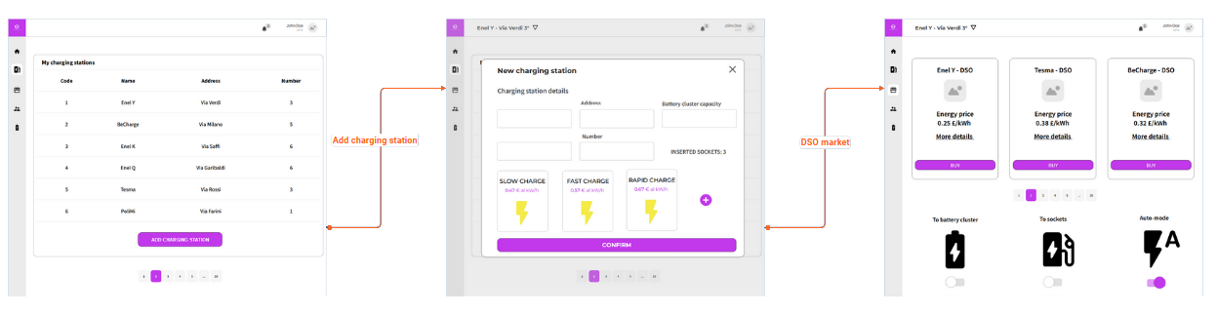
USE CASES – Charging Stations Management

Slide 8
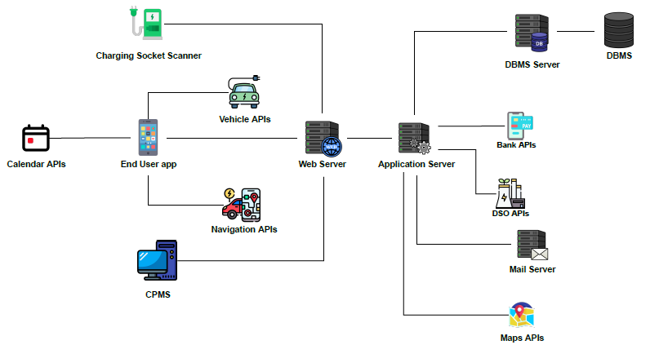
ARCHITECTURAL STYLE

Slide 9
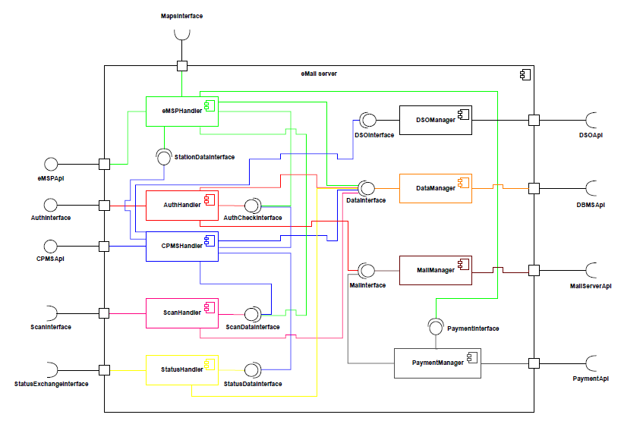
APPLICATION SERVER COMPONENTS

Slide 10
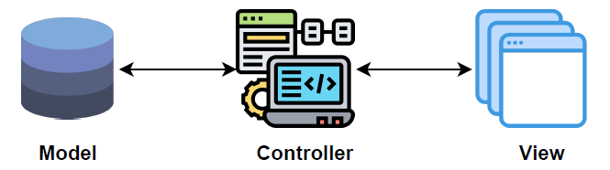
PATTERN - MVC

Slide 11
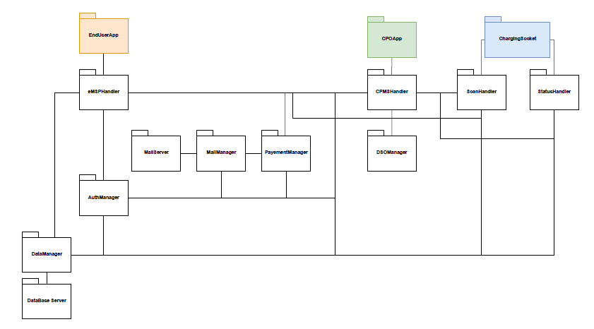
IMPLEMENTATION, INTEGRATION AND TESTING

Slide 12
eMall – e-Mobility For All
I&T
Software Engineering 2 Project
Academic year 2022 – 2023
Balestrieri Niccolò
Bertogalli Andrea
Tombini Nicolò

Slide 13
FRAMEWORKS & LANGUAGES
27% + 3%
30%
NODEJS and MOCHA
FLUTTER
30%
10%
REACTJS
JAVA FOR ANDROID

Slide 14
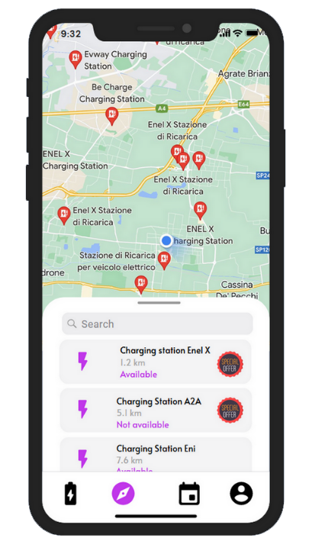
NEARBY CHARGING STATIONS
1
Current user latitude and longitude
2
Convertion charging station address to latitude and longitude
3
Nearby charging station selection according to user location
4
Return the nearest charging stations

Slide 15
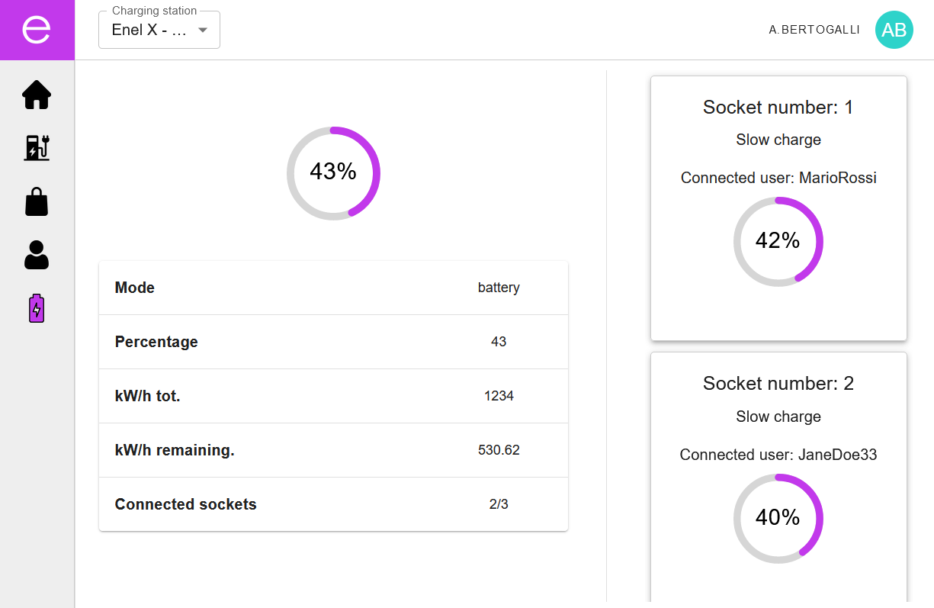
REAL-TIME CHARGE
1
Involves both eMSP and CPMS
2
Real-time syncronization over WebSocket protocol
3
Full-duplex communication, no polling
4
Uses rooms for targeted communications, no broadcast

Slide 16
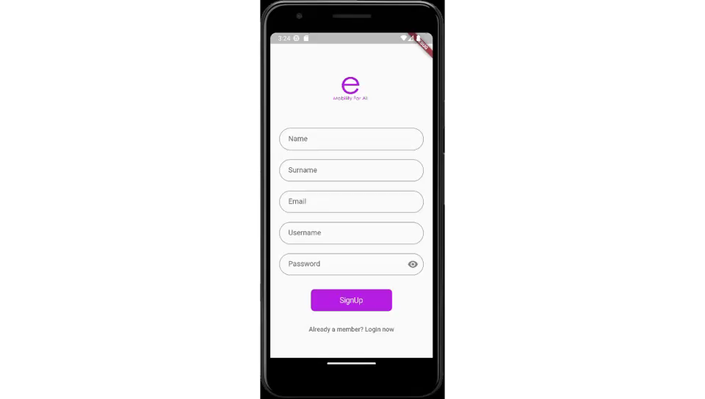
DEMO – EndUser App

Slide 17
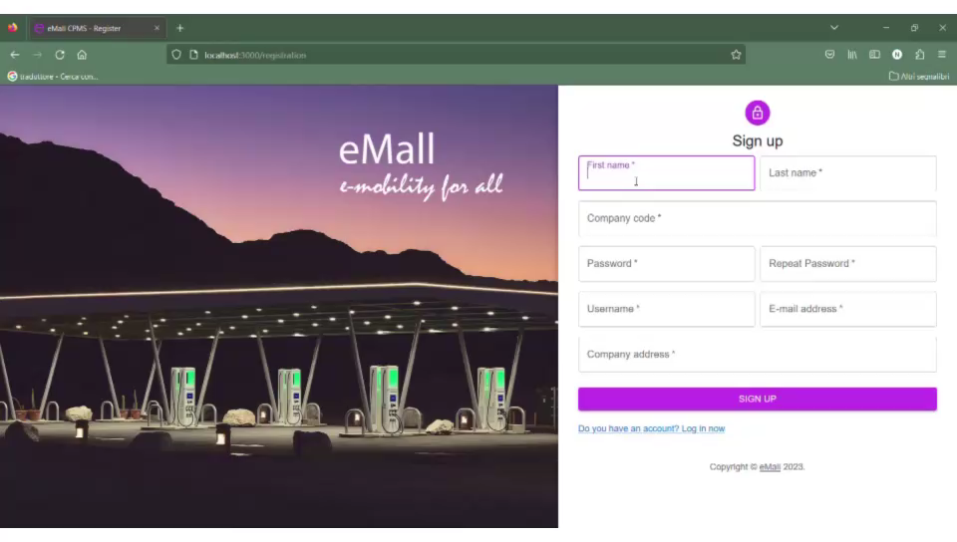
DEMO – CPO App

Slide 18
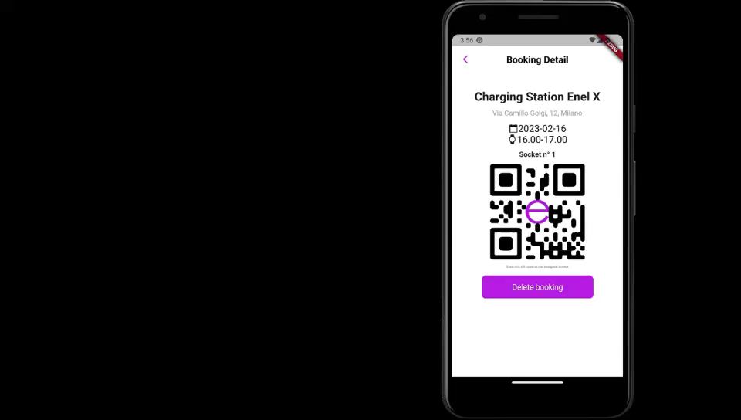
DEMO – Charge Process

Slide 19
THANKS FOR YOUR ATTENTION.
Software Engineering 2 Project
Academic year 2022 – 2023
Balestrieri Niccolò
Bertogalli Andrea
Tombini Nicolò

